Slide 1
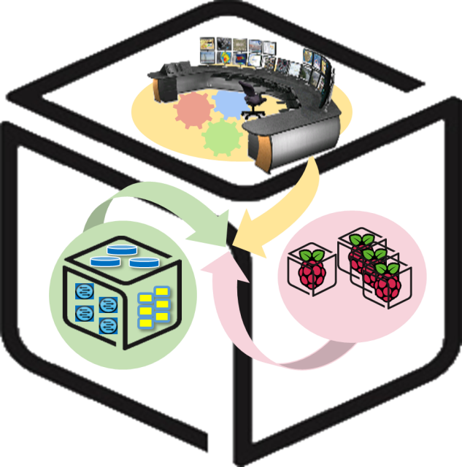
SmartX Labs for Computer Systems
SDN Lab v02
(2016, Spring)
NetCS Lab

Slide 2
History and Contributor of SDN Lab
(2016. 05. 01)
Version | Updated Date | Updated Contents | Contributor
v01 | 2016/04 | 전체 실습 자료, physical switch를 이용한 버전 작성 | 윤 희 범
v02 | 2016/05 | Network Emulator를 이용한 버전으로 수정 | 윤 희 범

Slide 3

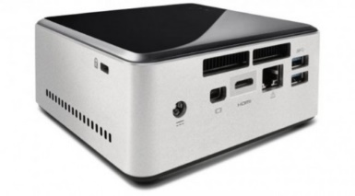


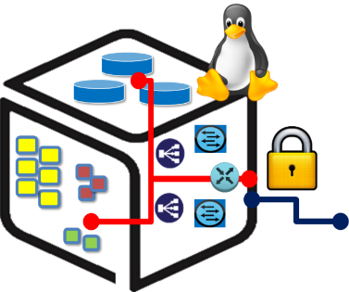


SDN Lab: Outline
OpenFlow-Connect
Box
Box

Slide 4
SDN LAB: Goals
Understanding Concepts
SDN Network
OpenFlow
ONOS SDN Controller
Setting & Configuration
Install SDN Controller, JDK and Mininet(1st week)
SDN Control & Understand/Follow Application (2nd week)

Slide 5
Part 1: Understanding Concept

Slide 6
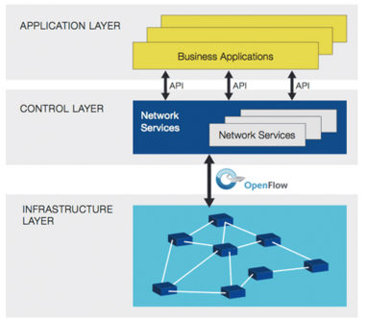
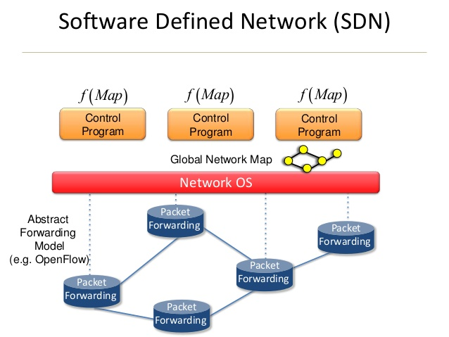
What is SDN ?
SDN(Software Defined Network):
The physical separation of the network control plane from forwarding plane, and where a control plane controls several devices.
Directly programmable: it is decoupled from forwarding functions.
Agile: Abstracting control from forwarding lets administrators dynamically adjust network-wide traffic flow to meet changing needs.
Centrally managed: Network intelligence is centralized in software-based SDN controllers
Programmatically configured: SDN lets network managers configure, manage, secure, and optimize network resources very quickly via dynamic, automated SDN programs
Open standards-based and vendor-neutral:
https://www.opennetworking.org/sdn-resources/sdn-definition

Slide 7
Why is SDN ?
Problem ( Traditional network)
Difficult to optimize
Network operators are finding it difficult to introduce new revenue generating services and optimize their expensive infrastructures: data centers, wide-area networks, and enterprise networks.
Known problems
Networks continue to have serious known problems with security, robustness, manageability, mobility and evaluability that have not been successfully addressed so far.
Capital costs
Network capital costs have not been reducing fast enough and operational costs have been growing, putting excessive pressures on network operators.
Difficult to customize
Even vendors and third parties are not able to provide customized cost effective solutions to address their customers’ problems.
Traditional networking approaches have become too complex, closed, and proprietary.
http://opennetsummit.org/archives/mar14/site/why-sdn.html

Slide 8
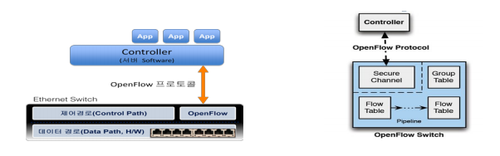

OpenFlow
OpenFlow
OpenFlow is an open standard that enables researchers to run experimental protocols in the campus networks we use every day.
OpenFlow is considered one of the first SDN standards. It originally defined the communication protocol in SDN environments that enables the SDN Controller to directly interact with the forwarding plane of network devices such as switches, routers both physical and virtual, so it can better adapt to changing business requirements.

Slide 9
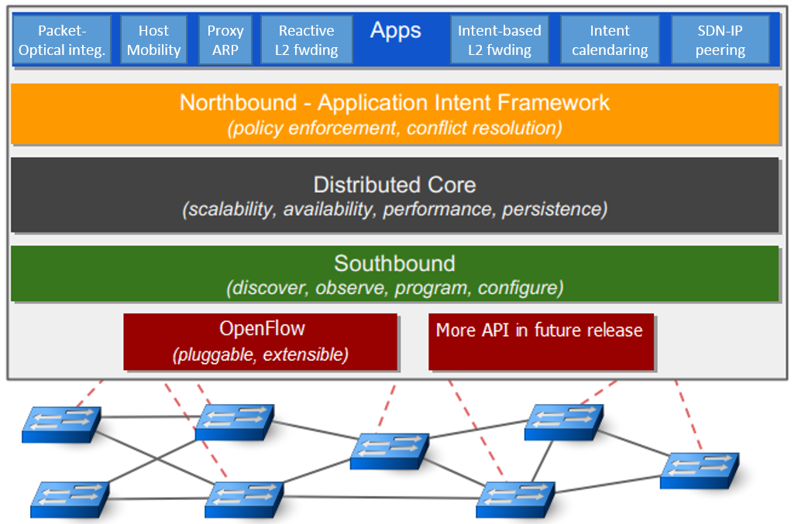
ONOS(Open Network Operating System)
ONOS
The Open Network Operating System(ONOS) is a software defined networking (SDN) OS for service providers that has scalability, high availability, high performance and abstractions to make it easy to create apps and services.

Slide 10
ONOS(Open Netowork Operating System)
ONOS Distributed Architecture Scalable Distributed Core for Scalability, HA, Performance.
Apps: Contains user applications (reactive forwarding, proxy arp, SDN-IP...)
NB Core API: Transfer network info to application layer Provide management interface for controlling lower layer component.
Distributed Core: Contains many core features. Provide distributed clustering function for supporting HA and scalability.
SB Core API: Provide a abstracted interface for controlling the network infra.
Protocols: Real network protocol implementation for managing the network elements. ( OpenFlow, NetConf)

Slide 11

Part 2: Setting & Configuration

Slide 12
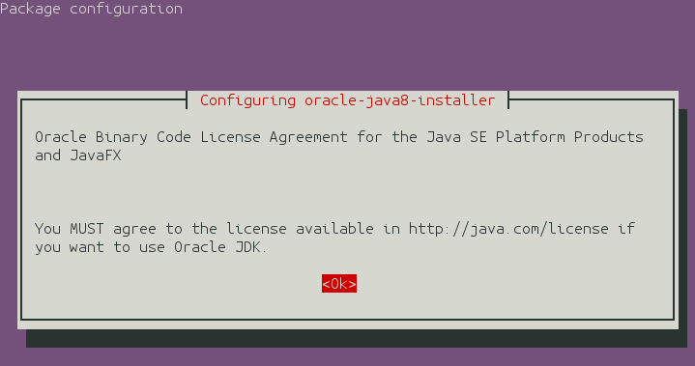
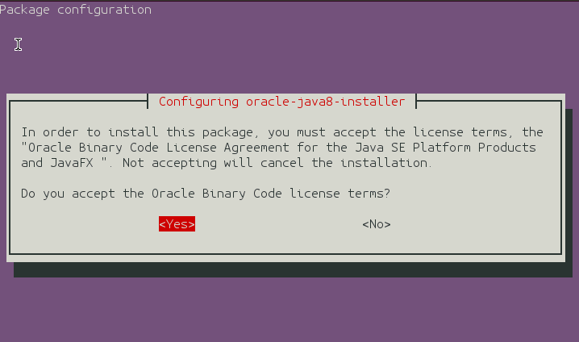
ONOS SDN Controller
ONOS SDN Controller install on NUC
Install Step
Install JAVA JDK 1.8
Install ONOS(2가지 방법)
직접 build 하는 방식: apache maven, karaf를 이용한 빌드
ONOS에서 제공하는 image 사용 (We use this way!)
JAVA JDK 1.8

Slide 13
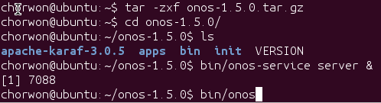
ONOS SDN Controller
ONOS SDN Controller install on NUC
Install Step
JAVA 1.8이 정상적으로 설치되었는지 확인
ONOS official releases download
https://wiki.onosproject.org/display/ONOS/Download+packages+and+tutorial+VMs

Slide 14
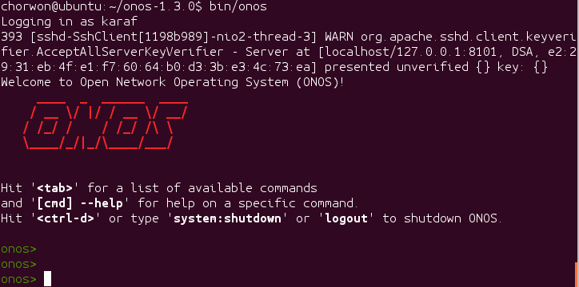
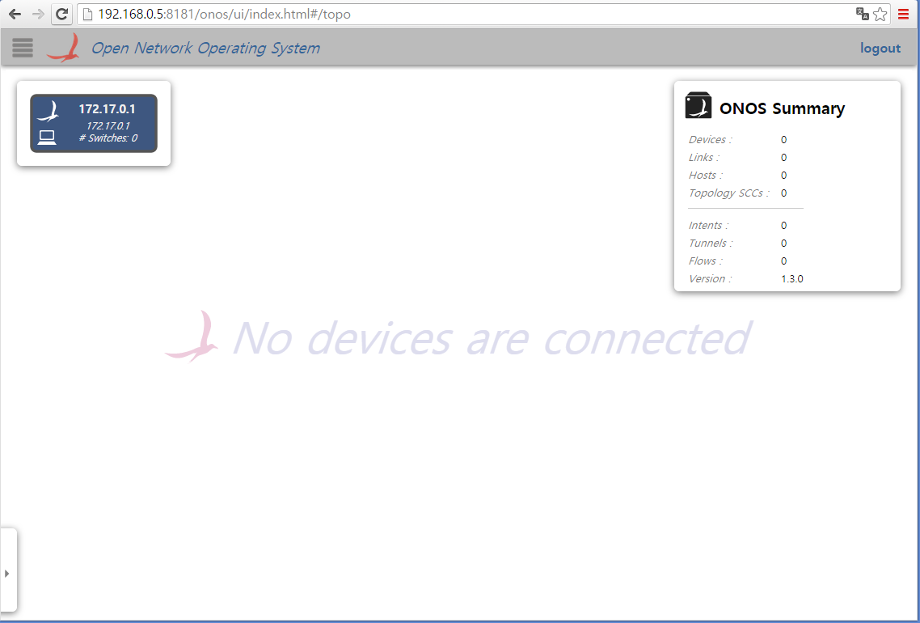
ONOS SDN Controller
ONOS SDN Controller install on NUC
Install Step
ONOS가 정상적으로 설치되었는지 확인
GUI 접속 http://[your NUC IP Address]:8181/onos/ui/login.html#/
karaf/karaf 로그인

Slide 15
Mininet
Mininet is a network emulator which creates a network of virtual hosts, switches, controllers, and links. Mininet hosts run standard Linux-network software, and its switches support OpenFlow for highly flexible custom routing and Software-Defined Networking.
Provides a simple and inexpensive network testbed for developing OpenFlow applications
Enables multiple concurrent developers to work independently on the same topology
Supports system-level regression tests, which are repeatable and easily packaged
Enables complex topology testing, without the need to wire up a physical network.
Includes a CLI that is topology-aware and OpenFlow-aware, for debugging or running network wide tests.
Provides a straightforward and extensible Python API for network creation and experimentation

Slide 16
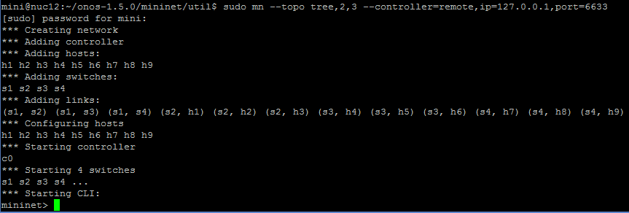
Mininet
Recommend using other terminal!!
Install Mininet
Start Mininet (we will make 4 switches and 9 hosts.)
It takes some time !

Slide 17
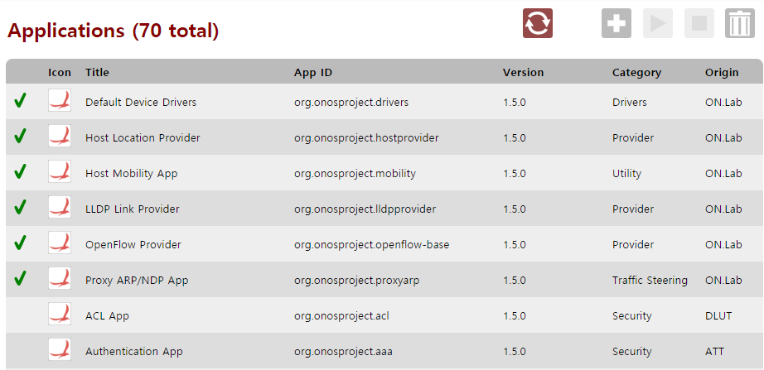
ONOS
In ONOS Web GUI, You can’t see any switch and host
You have to activate ONOS Applications first
In ONOS Web GUI,
Go to Menu->Applications tab
Activate bellow applications
Using this icon

Slide 18
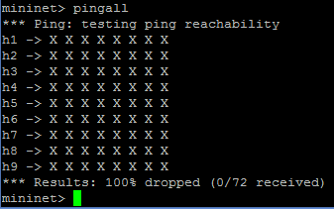
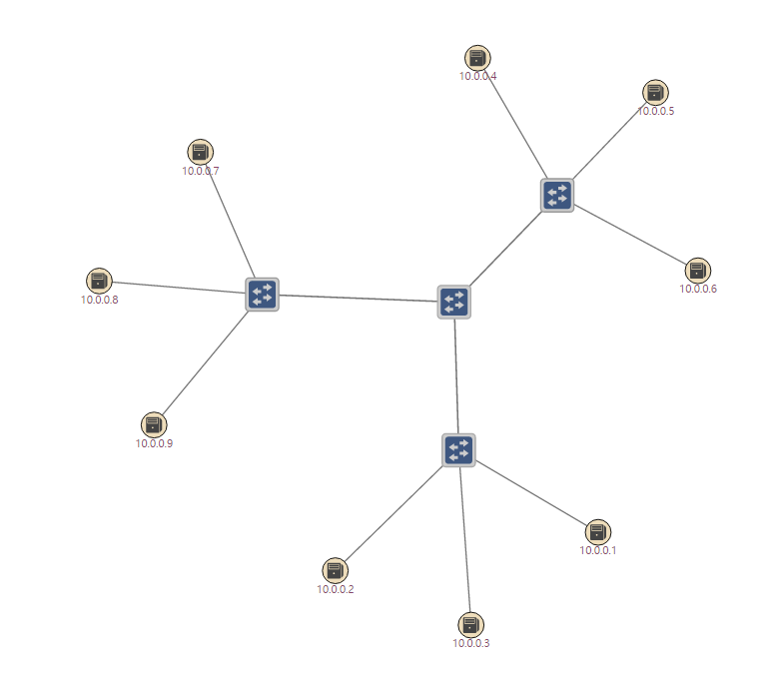
ONOS
In Mininet
Typing “pingall”
Then you can see hosts and switches in ONOS web GUI
You can’t send ping!

Slide 19
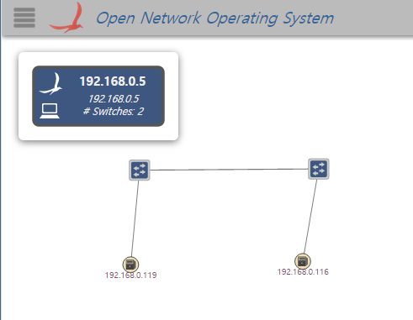
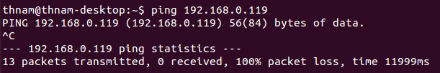
ONOS
정상적으로 연결 시, GUI에 다음과 같이 표현
192.168.0.119: Pi / 192.168.0.116: NUC
Ping Test
Fail because of no flow in switch
In ONOS, flow installation is possible using intent.
And Forwarding Application also supports communication between hosts.

Slide 20
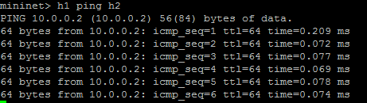
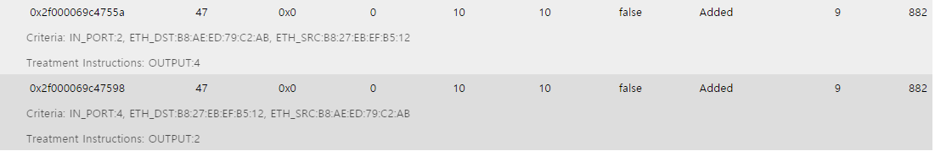
ONOS
Activate forwarding application.
Ping Test Again
해당 Flow

Slide 21
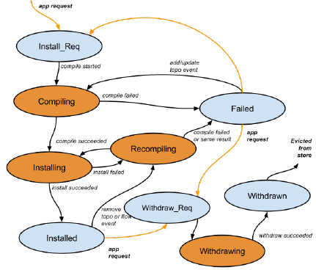
ONOS
Intent Subsystem
Overview
Provide a high-level interface that focuses on what should be done rather than how it is specifically programmed.
Abstract network complexity from applications
Extend easily to produce more complex functionality through combinations of other intents
Intent Framework
Programming abstraction
Intents
Compilers
Installers
Execution framework
Intent service
Intent store

Slide 22
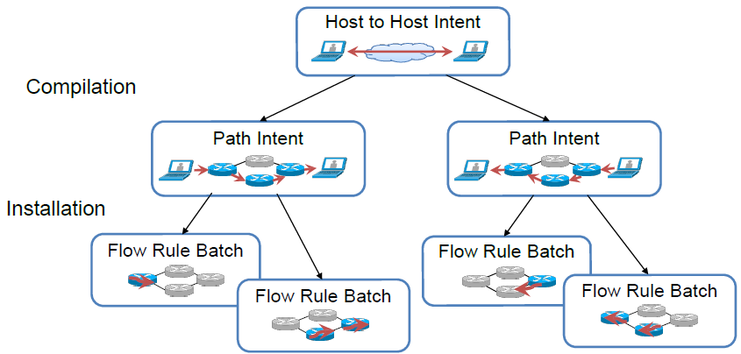
ONOS
Compiler & Installer
Compiler: produce more specific intents given the environment
Installer: transform Intents indo device commands

Slide 23
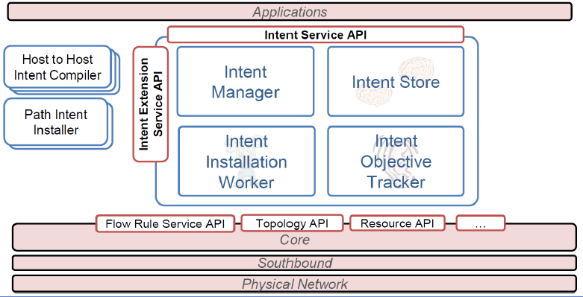
ONOS
Intent Framework
Translates intents into device instructions (state, policy)
Reacts to changing network conditions
Extends dynamically to add, modify functionality (compilers, installers)

Slide 24
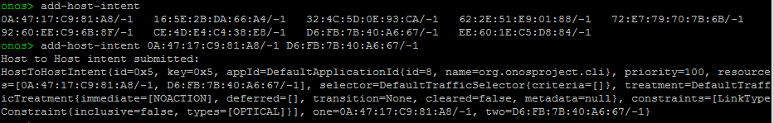
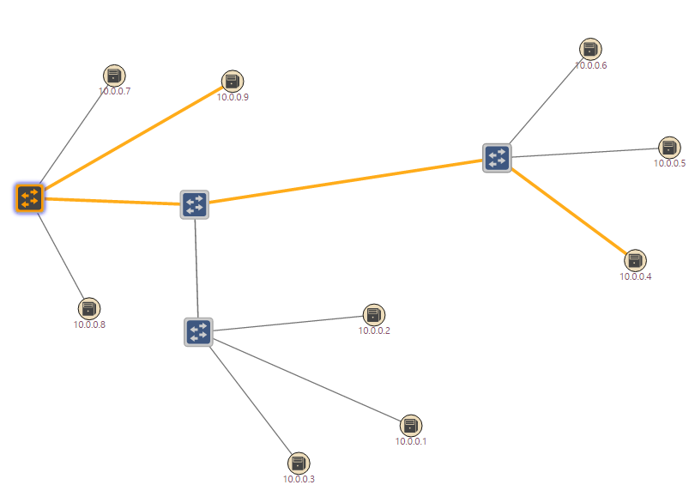
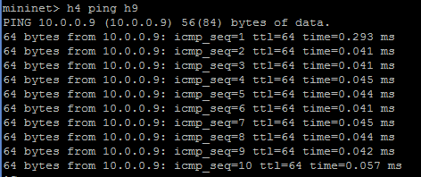
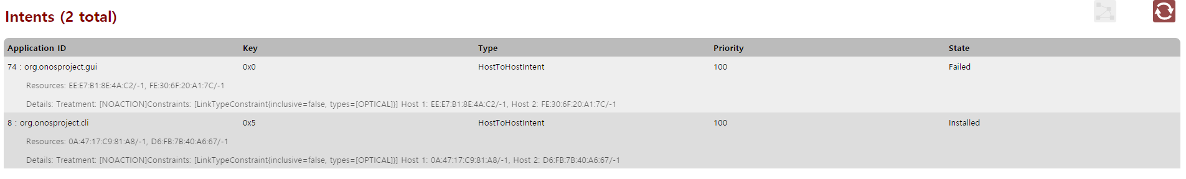
ONOS
Intent
Making Host-to-Host Intent between hosts(example h4 and h9)
After install intent, you can send ping

Slide 25
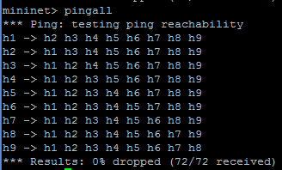

ONOS
Question
How can I use ‘pingall’ command in mininet successfully ?

Slide 26

Thank You for
Your Attention
Any Questions?

Slide 27
Appendeix

Slide 28


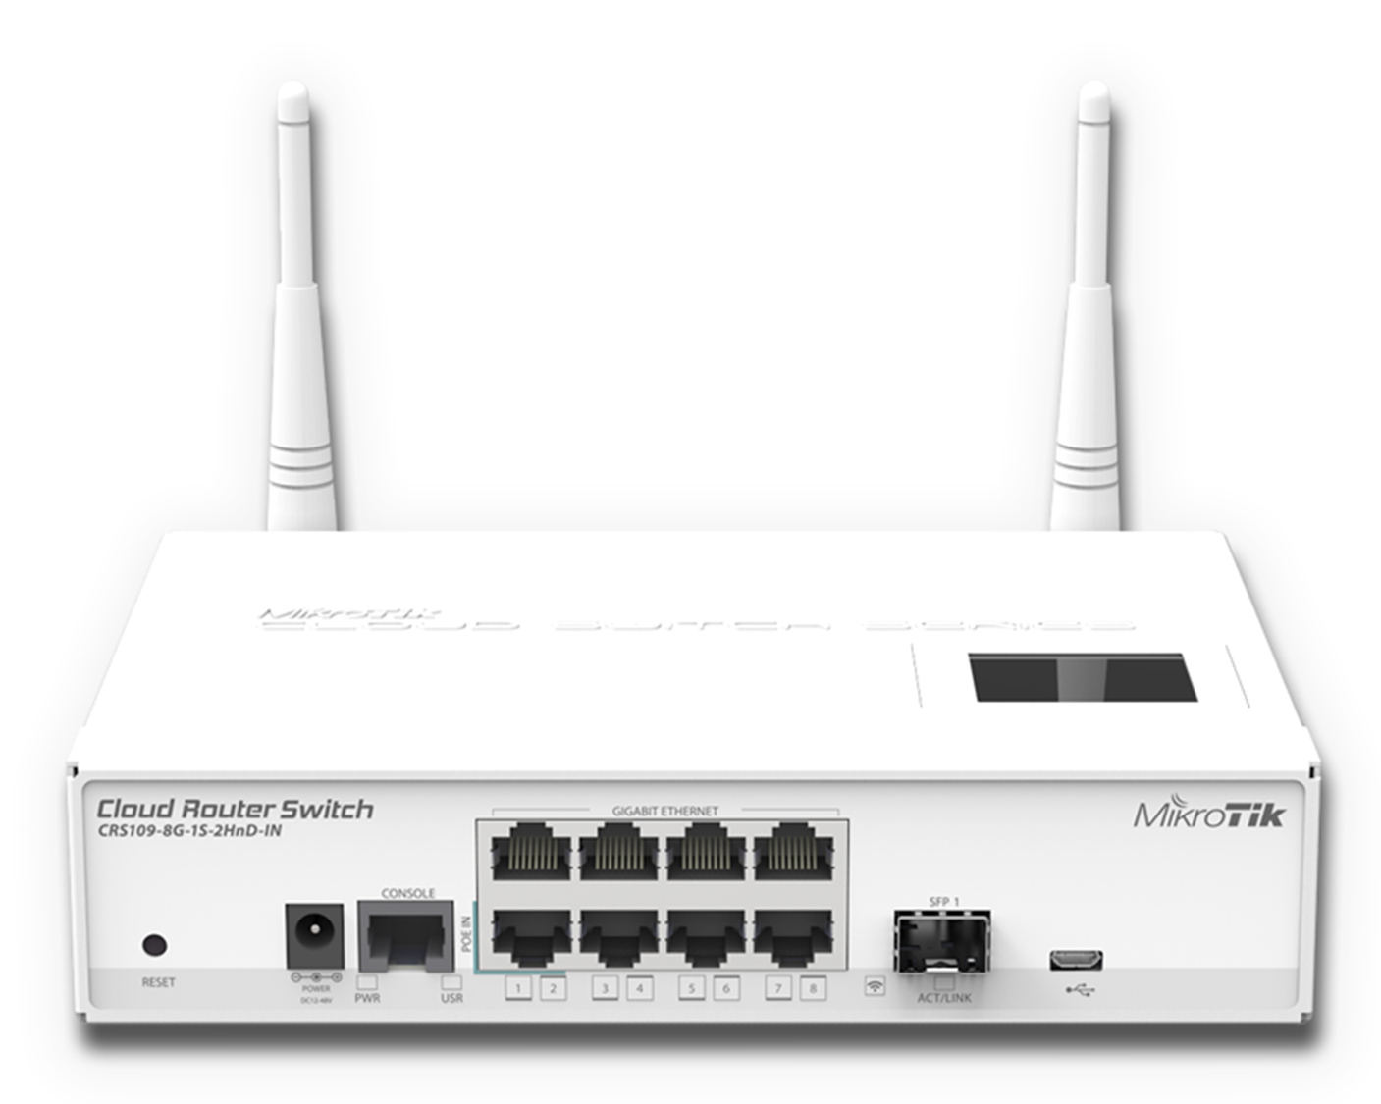


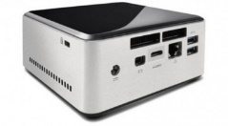
Overall SDN Setting Environment
ONOS server
Internet
NUC
192.168.0.x, NUC
Standard switch
192.168.0.x, switch
OpenFlow switch
192.168.0.x, switch
192.168.0.x, switch
Host
Standard connect
OpenFlow connect
192.168.0.x, Raspberry Pi
192.168.0.x, NUC

Slide 29
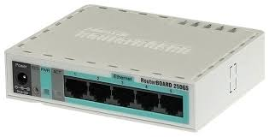
MikroTik Switch
SDN 실습을 위한 Switch Model
Mirkotik Cloud-Router Switch :CRS109-8G-2HnD-IN
Mikrotik Router Board : RB750 GL
OpenFlow 및 다양한 Network switch/router의 기능 지원 포함
OpenFlow 1.0 support ( NOT Perfect )
Cheap
Winbox : Mikrotik switch configuration tool (GUI 제공)
Mikrotik CRS109
Mikrotik RB750 GL

Slide 30
MikroTik Switch
Mikrotik switch setting (가정 사항)
SDN 환경 구축을 위해 우선 switch setting 필요.
제안하는 switch setting : 가장 간단한 스위치 설정을 위해 모든 Mikrotik 스위치를 우선 Hub로 동작하게끔 설정.
IP는 Public/Private 둘 중 어느 것으로 설정해도 상관 없으나 모든 머신들이 같은 네트워크 대역에 포함해야 함. (강의 자료에선 private network 사용)
NUC 외부와의 접속 가능한 환경
다음과 같은 환경을 가정한 상황에서 진행
Internet
NUC

Slide 31

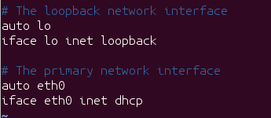
MikroTik Switch
Mikrotik switch setting (가정 사항)
Setting 방법
NUC으로 접속
Mikrotik switch settin을 위한 Configuration tool :Winbox 설치 on NUC
다음 명령어 입력
Mikrotik 스위치(8port)를 아래와 같이 외부 접속이 되는 다른 스위치 혹은 외부 접근이 되게끔 연결(8-port 스위치의 1번 port에 연결!)
NUC은 2~8번 port 중 하나에 연결 그 후, 다음 명령어 실행

Slide 32
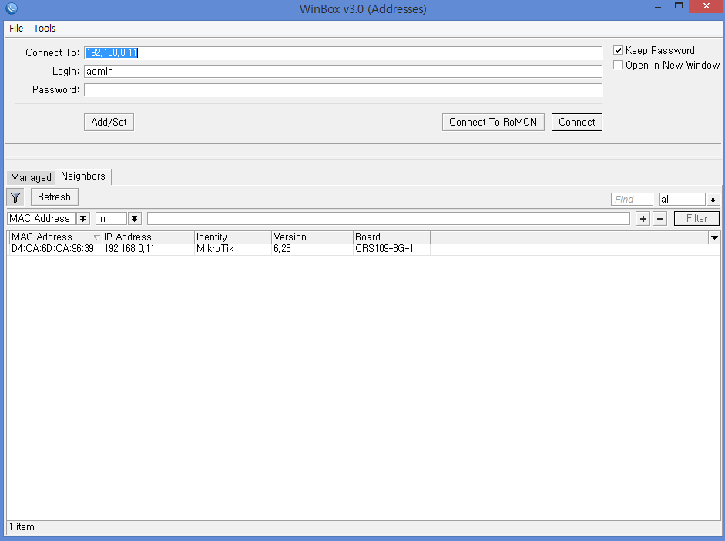
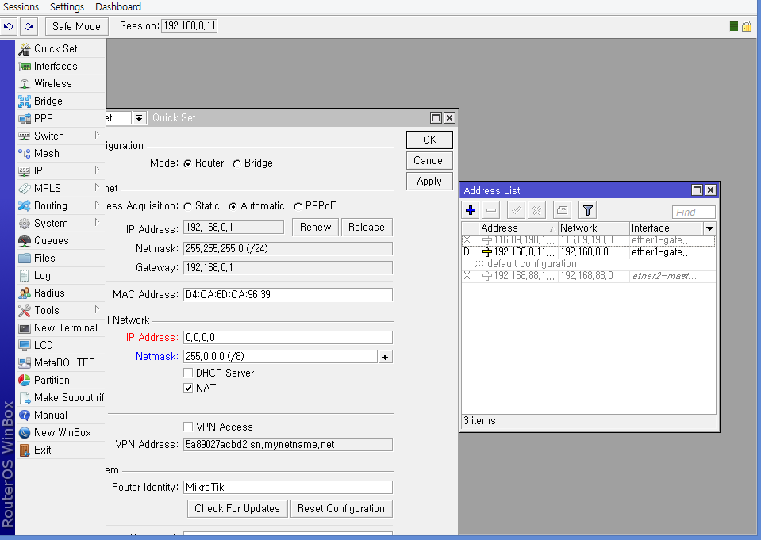
MikroTik Switch
현재까지 진행된 사항
NUC에서 다음과 같이 입력
Default 접속 정보 ID: admin password: 없음
Winbox로 접속 후, 1번 port를 제외한 모든 port의 master-port를 1번 port로 설정
Internet
NUC
192.168.0.5
DHCP
1
* DHCP server가 여기 있어도 상관 없음
Internet
192.168.0.11

Slide 33
MikroTik Switch
같은 방식으로 switch를 모두 setting
정상적으로 setting 할 경우, 다음 그림과 같은 토폴로지 구성이 완료되어야 함
http://www.mikrotik.com/download 접속 후, Router OS를 최신 버전으로 다운 (Main package, extra package 모두 받은 후, winbox의 files 탭을 열고 복사
Winbox의 new terminal 창을 열고 system reboot 입력
Internet
NUC
192.168.0.5
DHCP
1
* DHCP server가 여기 있어도 상관 없음
192.168.0.11
1
1
192.168.0.12
192.168.0.15

Slide 34
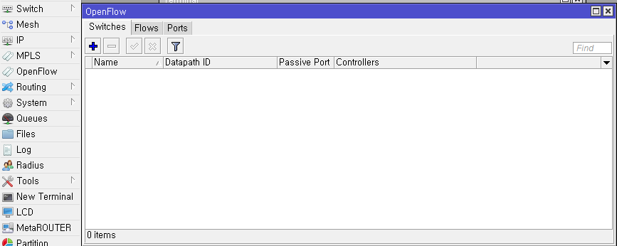
MikroTik Switch
ONOS를 정상적으로 설치 후, Switch의 OpenFlow 설정 필요.
정상적으로 setting 할 경우, 다음 그림과 같은 토폴로지 구성이 완료되어야 함
Winbox를 이용해 192.168.0.12, 192.168.0.15 Mikrotik 스위치의 openflow 설정
해당 스위치의 winbox에서 OpenFlow 탭 클릭
Internet
NUC
192.168.0.5
DHCP
1
* DHCP server가 여기 있어도 상관 없음
192.168.0.11
1
1
192.168.0.12
192.168.0.15

Slide 35
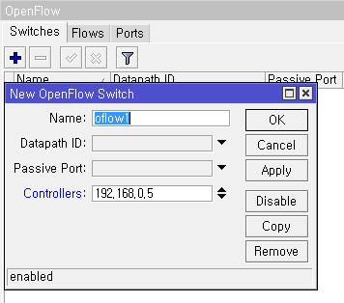
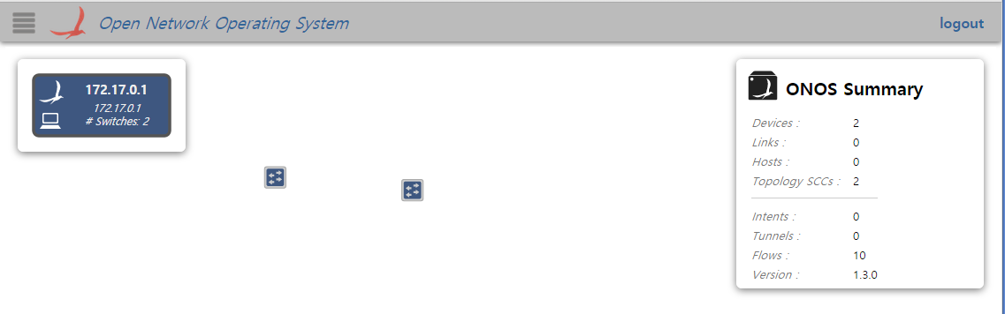
MikroTik Switch
OpenFlow 탭의 + 버튼을 누르고 ONOS가 설치된 NUC의 IP 주소 입력
정상적으로 입력하면, ONOS GUI에 두 개의 스위치가 나옴

Slide 36
MikroTik Switch
ONOS GUI에 스위치가 정상적으로 나오지 않는 경우, ONOS CLI에서 다음과 같이 입력
ONOS GUI에 정상적으로 2개의 스위치가 나왔으면, 이제 두 스위치를 연결해야 한다.
192.168.0.12 스위치와 192.168.0.15 스위치의 각 3번 port끼리 연결 후, 각각 3번 port의 master-port를 none으로 설정 (winbox의 interface 탭에서 설정)
각 switch의 OpenFlow 탭에서 3번 port를 추가
Internet
NUC
192.168.0.5
DHCP
1
* DHCP server가 여기 있어도 상관 없음
192.168.0.11
1
3
3
1
192.168.0.12
192.168.0.15

Slide 37
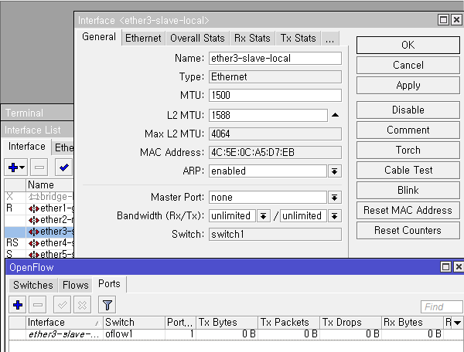
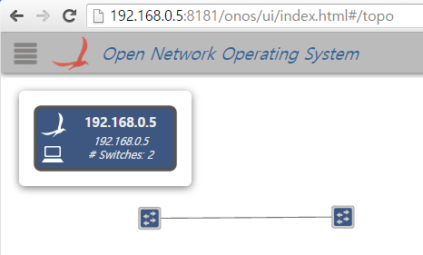
MikroTik Switch
다음과 같이 port setting 필요
정상적으로 설정 할 경우, 오른쪽 그림과 같이 두 스위치간 링크 생성.

Slide 38
MikroTik Switch
Mikrotik 스위치에 Host 연결
Switch 연결과 같은 방식으로 port Setting.
Internet
NUC
192.168.0.5
DHCP
1
* DHCP server가 여기 있어도 상관 없음
192.168.0.11
1
3
3
1
192.168.0.12
192.168.0.15
4
4

